Slide 1

Weak-lensing mass determination of the galaxy cluster Abell3926
presented by: Abdelhamid Haddad
Supervised by: Pr. Nicolas Martinet

Slide 2
Outline
Overview:
  General introduction.
  Gravitational lensing.
The Abell3926 cluster.
Computational part:
  Intermediate preparations.
  Concluding results and perspectives.

Slide 3
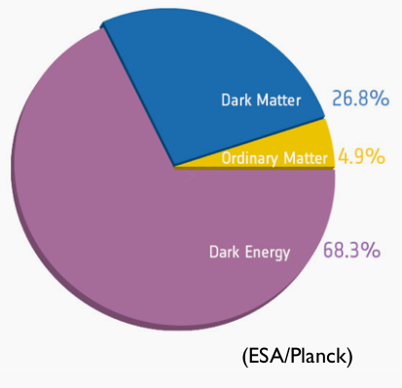
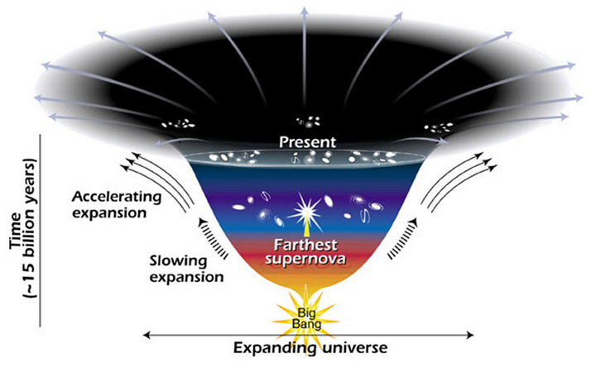
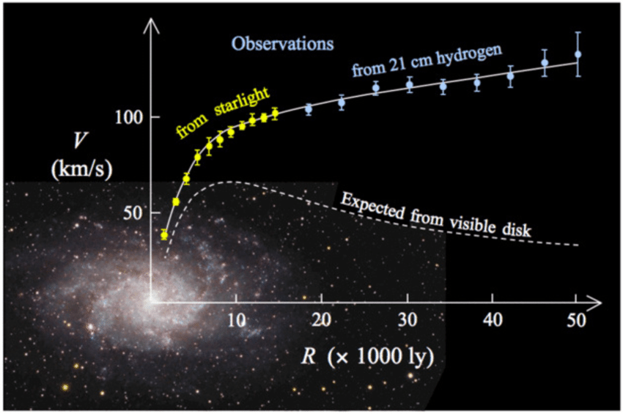
General Introduction
Almost all of it are from unknown components : dark energy and dark matter.
Could “explain” many observations in a
consistent manner.
ESA/Hubble

Slide 4
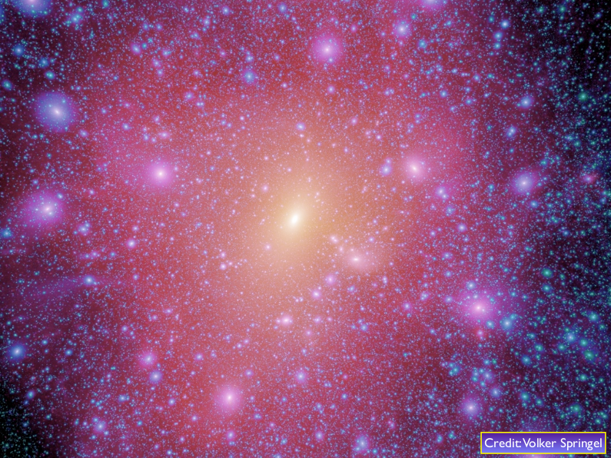
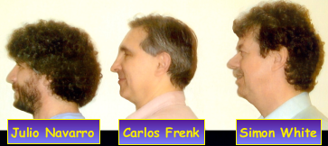

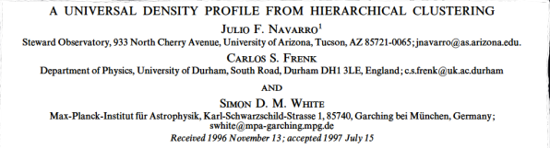
The NFW Profile
In 1997, Navarro, Frenk & White wrote a seminal
paper in which they showed that the density
profiles of the dark matter haloes can always be fit by a universal fitting function: the NFW profile !

Slide 5
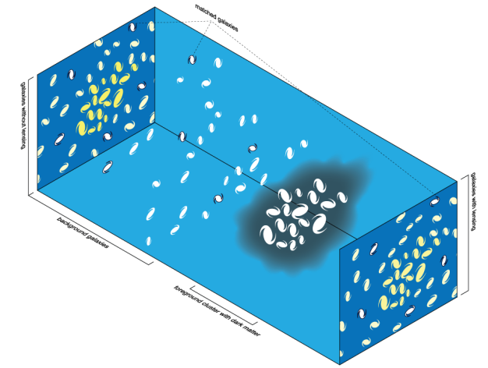
Gravitational lensing
Image by Michael Sachs [CC BY-SA 3.0 or GFDL], via Wikimedia Commons

Slide 6
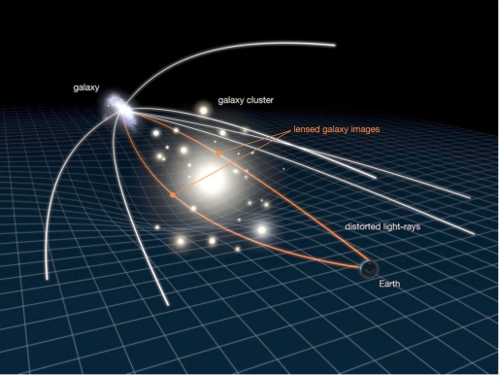
Gravitational lensing
Image: cfhtlens.org

Slide 7
(Weak) lensing parameters
(Measuring shear)
except for rare cases, lensing effect is weak.
observed shape is affected by weak lensing distortion :
                ϵ_{i}^{obs} = ϵ_{i}^{int} + γ_{i}
shear is measured by averaging observed galaxy shapes.
we can extract information on the cluster by fitting the observed shear profile with a model.

Slide 8
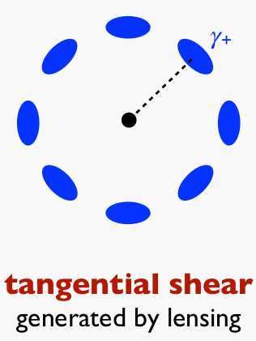
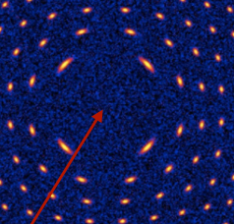
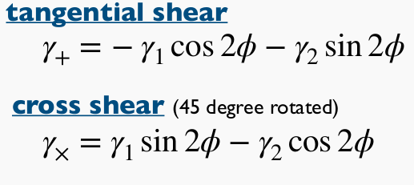
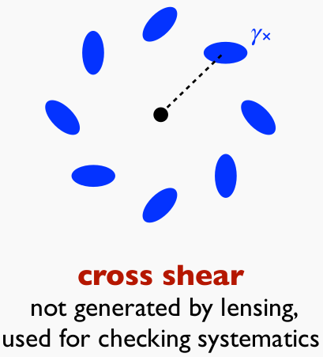
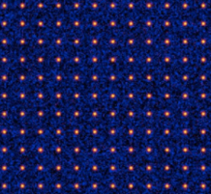
Tangential and cross shear
Masamune Oguri, ITB Online Summer School on Galaxies dan Cosmology 2020
The lens distorts shapes of background galaxies along tangential Direction.
Thus, by measuring the tangential shear, we could obtain the mass dist.
simulated by glafic

Slide 9
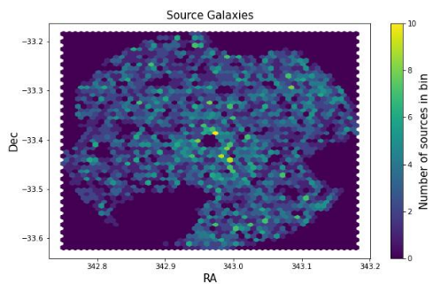
The Abell3926 cluster
Covered by the Kilo Degree Survey (Path G23)
(342.9, -33.4)
Positions (Ra,Dec).
Photo-metric redshift
Ellipticities (e₁,e₂).
ect.

Slide 10
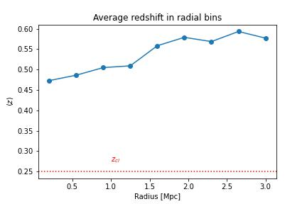
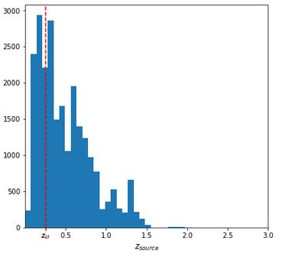
Intermediate Computation
(Selecting background galaxies)

Slide 11
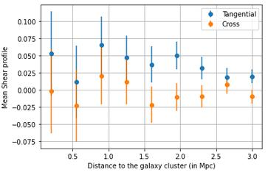
Tangential and cross shear profiles
Tangential shear
Significantly detected
cross shear
consistent
with zero
as expected

Slide 12
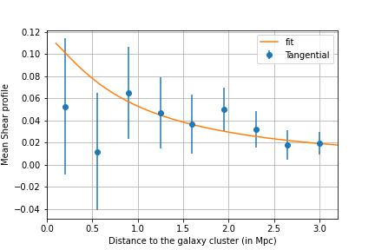
NFW fitting result
(good fit achieved)
Analytic expression
of tangential shear expressed by : Wright & Brainerd
C₂₀₀= 1.801 +/- 0.886
r_{s} = 1.585 +/- 0.907 Mpc

Slide 13
Concluding results
We could then compute the mass M₂₀₀ enclosed in a sphere of radius r₂₀₀ as :
            M₂₀₀ = (3.608 +/- 8.165).10¹⁵ M_{sun}
Additionally, and because the degeneracy of c₂₀₀ and r₂₀₀ (r₂₀₀ ₌ r_{s} . c₂₀₀), we fixed C₂₀₀= 3.5 and obtain :
            M₂₀₀ = (2.616 +/- 0.589).10¹⁵ M_{sun}

Slide 14
Conclusions
Weak gravitational lensing provides a powerful means of studying of dark matter distribution.
We need many galaxies with accurate shape measurements, but we have also to be more careful with :
  The selected background galaxies.
  The binning of our tangential shear.
  Try different cluster centers.

Slide 15
Thanks for your Attention !
Your questions are more than welcomed :)

